Slide 1



Introduction of the presentation of the interships
Presentation of Internships
By Lucas Kacem
Subject 1 : Modeling & simulation of scenario for indoor/outdoor monitoring of aged people : Application to people in lost of autonomy
Supervision of :
Mme Marie-Agnès Peraldi-Frati – Tutor
M. HUYNH Huu Hung-Tutor

Slide 2


Plan of the presentation
Presentation of the University
Presentation of the topics and the team
Presentation of the architecture of the solution
First solution : value input by the user
Second solution : reading files .CSV
Planning
Retrospective
Conclusion

Slide 3
Presentation of the entreprise (1/3)
Presentation of DNITT : UCA and University Danang
Danang Nice Institute of technologie (DNITT) is part of the logic initiative deployement of excellence (IDEX)
UCA consists in projecting international
research and innovation projects or mirror sites
3

Slide 4
Presentation of the entreprise (2/3)
Presentation of Mire
Mire is a collaboration project between University Danang (UD) and l’Université de Nice (UNS) to promote knowledge sharing innovation and research at the University of Da Nang (UD)
4

Slide 5
Présentation de l’entreprise (3/3)
Presentation of SLEGO project
Slego permits to realise experiences either in simulation modle in the environment of development and or realize experiences realtime monitore
Slego permits to realise experiences either in simulation mode in development environment and realize experiences in real time and to follow up their execution in real time
5

Slide 6


Presentation of the subjects (1/1)
Subject 1 : Modeling & simulation of scenario for indoor/outdoor monitoring of aged people : Application to people in lost of autonomy
Subject 2 : Scenario execution for indoor/outdoor monitoring with sensors data injection: Application to people in lost of autonomy
Subject 3 : Secured architecture for the deployement of IoT Services : Application to people in lost of autonomy
6

Slide 7


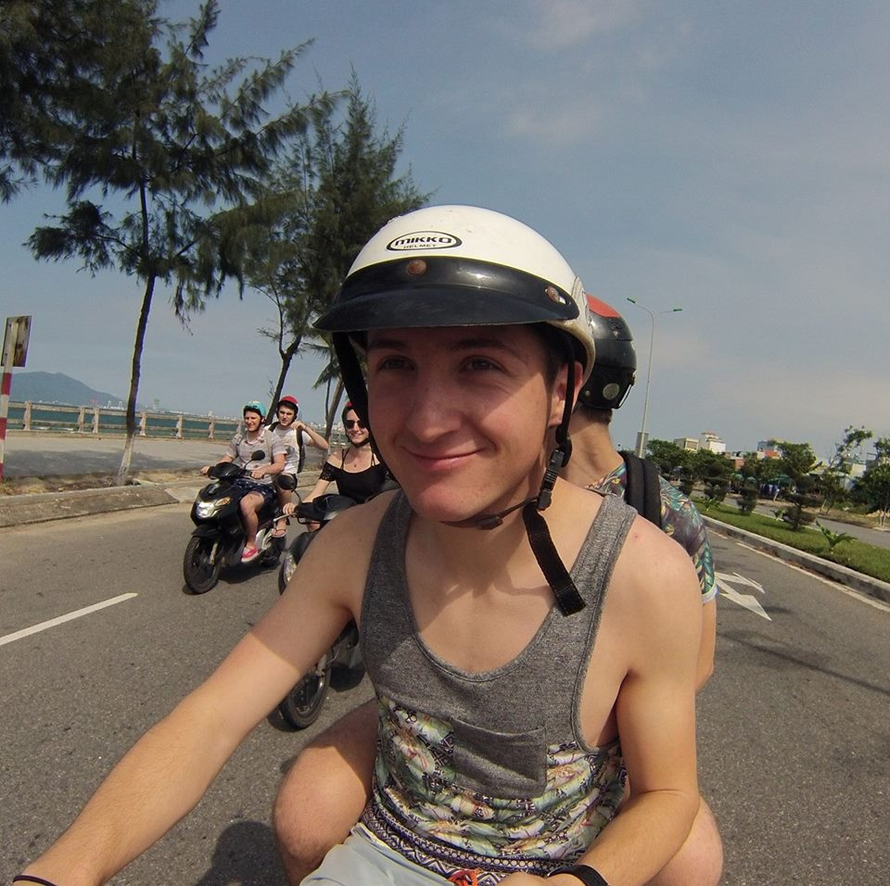

Presentation of the team (1/1)
Lucas Kacem DUT INFO
Anicet Gorgerin
DUT GEII
Alexi Cuellar-Primot
DUT GEII
Sebastien Saez
DUT INFO
Subject 1
Subject 2
Subject 3
7

Slide 8
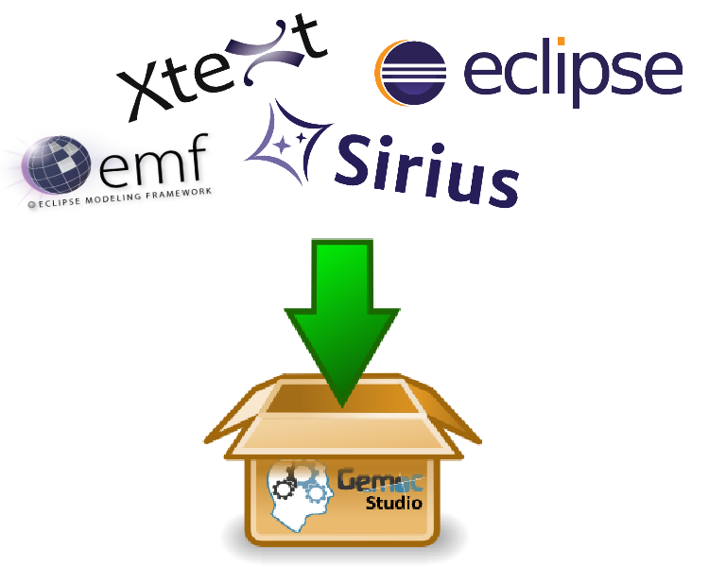
Presentation of Gemoc (1/3)
Gemoc (Globalization of Modeling Languages) what is it?
Gemoc is an IDE develops by INRIA in partnership with several Universities all over the world
tool based on Eclipse which integers several plugins as Text,Sirius,Emf and also TimeSquare
Gemoc offers an integrated environement enabling languages definition and graphic models and for textual ones their simulation
Specific at applications domains
In our case there is description of scenarios of activities processing data flows with SigPML
8

Slide 9
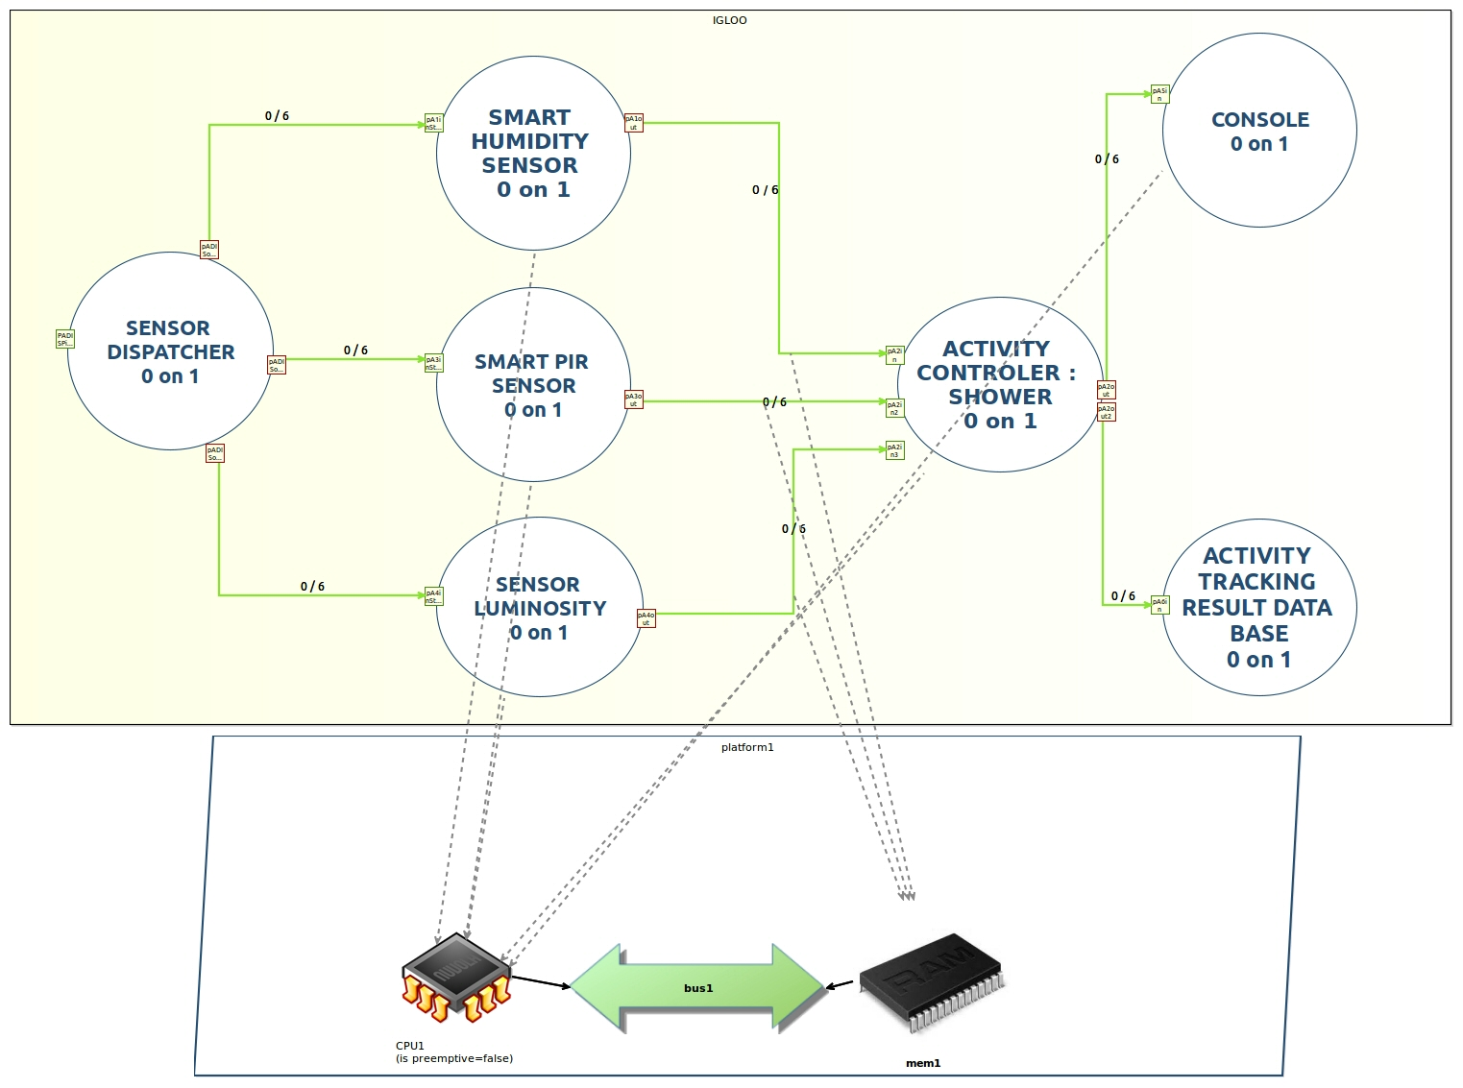
Presentation of Gemoc (2/3)
How works SigPML ?
SigPML is a modélisation language specific of fields dedicated to data stream processing
The concrete syntax is based on agents, sensor to create a directed flow
The semantics of execution is defined in Gemoc and then make the executable and be simulated model
We are working at part level modelling workbench
9

Slide 10



Presentation of Gemoc (3/3)
How work an agent ?
Agent
The agent can send
a result value to its port
An agent can take
an input value from
its port
The behaviour is given by a java code inside
The agent executes the code, can print graphical ,
and send the result value to other agent through its port
10

Slide 11
Objectif du stage (1/1)
Objectif of this intership
Description activity of folow persons
Taking and work with data of sensor
Taking and work with data on a MQTT file ( format CSV)
Printing and sending of result in graphical version and in a data base
11

Slide 12


Présentation de l’architecture de la solution (1/5)
This agent is in relation with sensor
At this place the agent select the data from the Excel File or the input user and the orther agent is a dispacher
This agent print the result more graphicaly
This agent take the data of sensor and give a boolean
to see if yes or no the person with this data take a shower
We stock the data of this agent
into a DATABASE
12

Slide 13

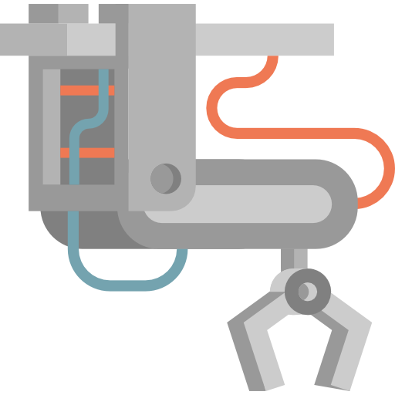




Presentation of the architecture (2/5)
Architecture of solution: The dispatcher ?
With the dispatcher we can read .csv file or take values of user and we can extract the necessary information to transmited into different sensors
13

Slide 14
Presentation of the architecture (2/5)
Architecture of the solution: Different sensors present in the project
This one can capture humidity in a room. The values transmit are between 0 and 100,knowing that 100 is the maximum value possible.The values transmits are in percentage.
The PIR sensor is an movement sensor that can determinate if a person is in a room or not.The values are between 0 and 1 . 0 is when the movement is null and 1 when the movement exists.
The Luminosity sensor has values between 0 and 500 knowing that at the 120 value, we consider that the light is turn on .
14

Slide 15
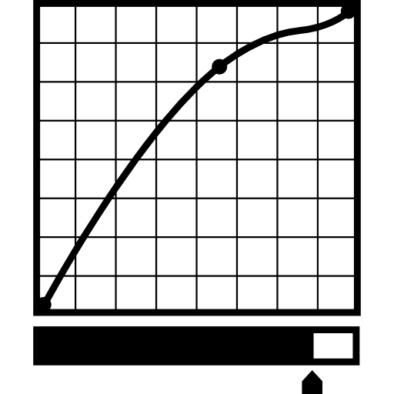



Presentation of the architecture (4/5)
Architecture of the solution: controlor agent
To do that, we get all the different values transmited by sensors and, due to an algorithm present in the sensor, we can evaluate if the values still increase or not.
If the values increase, then we send to the next agent(the agent who takes care about graphical part) a positive answer 1 or negative so 0.
15

Slide 16



Presentation of the architecture (5/5)
Architecture of the solution: graphical agent
In order to take the modélisation and the comprehension easier for a novice user we have implemented an agent who he uses the java library : swing.
In fact, according to the value sends by the agent ,we print a window describing the state of the simulation in the moment ( if a person is taking a shower or not)
16

Slide 17
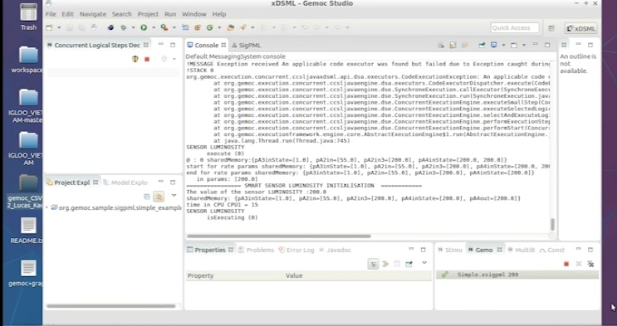
First solution : value input by the user (1/2)
17

Slide 18


First solution : value input by the user (2/2)
  Possible evolution
  Storage data in an external database and in real time
  Graphical printing for take the user data of sensor
  Configuration of terminal ( more clearly , delete warning )
  Printing sensor data in graphical mode like subject 2
  Printing directly online and in direct on a website
18

Slide 19
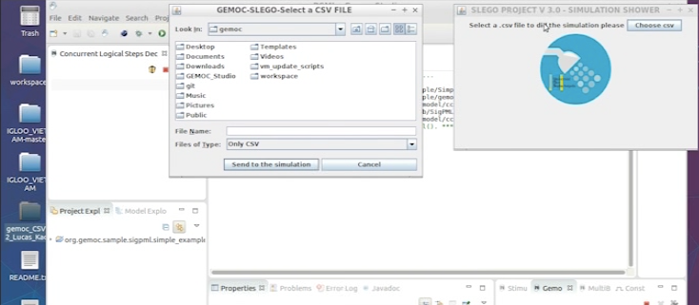
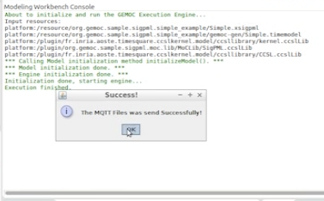
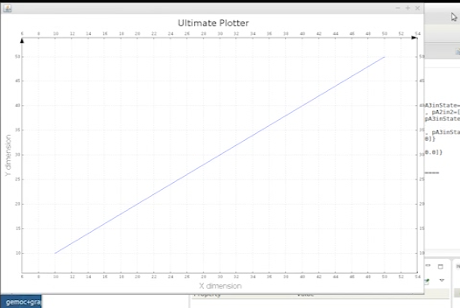
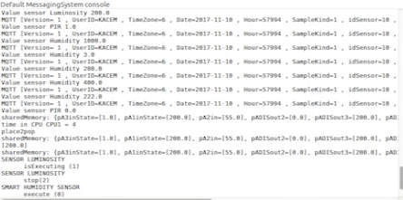
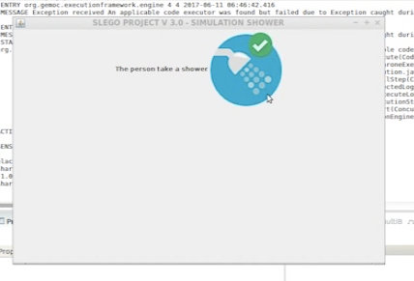
Second solution : reading files .CSV (1/2)
19

Slide 20
Second solution : reading files .CSV (2/2)
  Possible evolution
  Configuration of terminal ( more clearly , delete warning )
  Storage data in an external database and in real time
  Printing directly online and in direct on a website
20

Slide 21

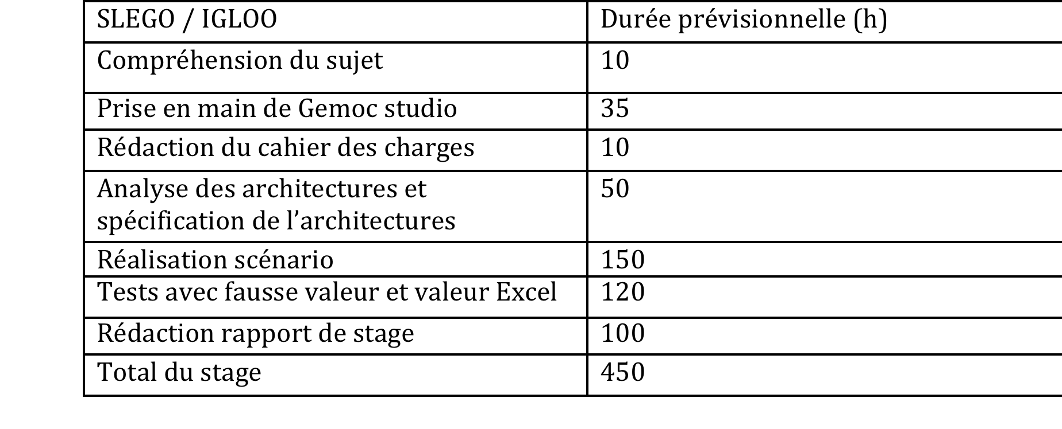
Planning (1/2)
21

Slide 22
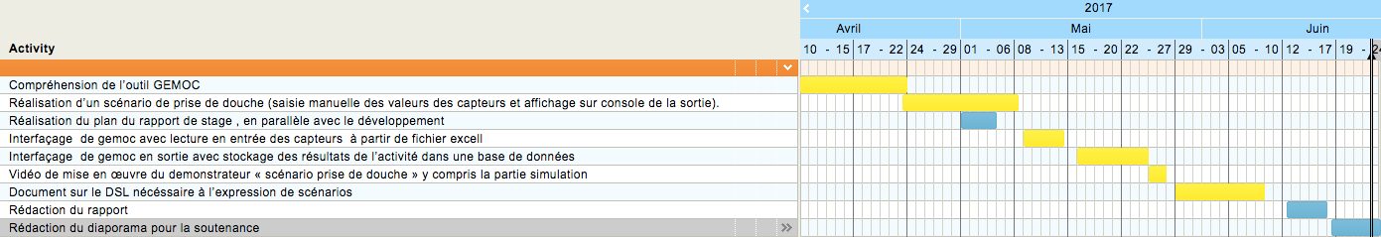
Planning (2/2)
22

Slide 23




Quantification of Activities (1/1)
746 line of code with Java
23 Agents created
832 Tests with Modeling SigPML Workbench (debug)
127 documentation pages readed
(gemoc initiative et github)
23

Slide 24
Rétrospective
What is done and What is needed to be done

Slide 25

Conclusion
Improvement of my autonomy
Capacity to learn and to adapt to new IDE
Improvement of my capacity to work in group (planification , Kan ban,ect)
Open-mindedness and thirst for learning in new domain as electricity or the domain of smart object
Learning of new knowledge in the specific domain ( electricity and IOT )
I share a video on youtube where you can see the subject 2 in action at this link : bit.ly/2t94Pu3

Slide 26

Question ?

